Slide 1
COSC 4370 Fall 2023 Interactive Computer Graphics M & W 5:30 to 7:00 PM
Prof. Victoria Hilford
PLEASE TURN your webcam ON
NO CHATTING during LECTURE

Slide 2
COSC 4370
5:30 to 7
PLEASE
LOG IN
CANVAS
Please close all other windows.

Slide 3

NEXT.

Slide 4




VH, publish
VH, publish
VH, publish

Slide 5


Slide 6
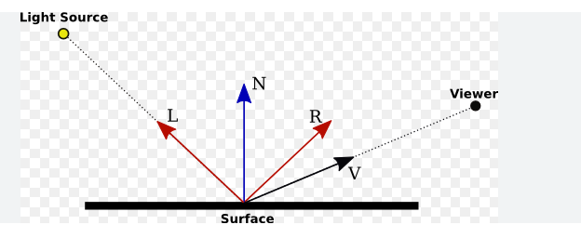
Lecture 6 Lighting and Shading Chapter 6
COSC 4370 – Computer Graphics

Slide 7
SUMMARY and NOTES
We have developed a lighting model that fits well with our pipeline approach to graphics. With it, we can create a variety of lighting effects, and we can employ different types of light sources. Although we cannot create the global effects of a ray tracer, a typical graphics workstation can render a polygonal scene using the modified Phong lighting model and smooth shading in the same amount of time as it can render a scene without shading.
From the perspective of an application program, adding shading requires only setting parameters that describe the light sources and materials. In spite of the limitations of the local lighting model that we have introduced, our simple renderer performs remarkably well; it is the basis of the reflection model supported by most APIs, including OpenGL.
Programmable shaders, which we will consider in Chapter 9, have changed the picture considerably. Not only can we create new methods of shading each vertex, but also we can use fragment shaders to do the lighting calculation for each fragment, thus avoiding the need to interpolate colors across each polygon. Methods such as Phong shading that were not possible within the standard pipeline can now be programmed by the application programmer and will execute in about the same amount of time as the modified Phong shader.
Notes:
We have developed a lighting model that fits well with our pipeline approach to graphics. With it, we can create a variety of lighting effects, and we can employ different types of light sources. Although we cannot create the global effects of a ray tracer, a typical graphics workstation can render a polygonal scene using the modified Phong lighting model and smooth shading in the same amount of time as it can render a scene without shading. From the perspective of an application program, adding shading requires only setting parameters that describe the light sources and materials. In spite of the limitations of the local lighting model that we have introduced, our simple renderer performs remarkably well; it is the basis of the reflection model supported by most APIs, including OpenGL. Programmable shaders, which we will consider in Chapter 9, have changed the picture considerably. Not only can we create new methods of shading each vertex, but also we can use fragment shaders to do the lighting calculation for each fragment, thus avoiding the need to interpolate colors across each polygon. Methods such as Phong shading that were not possible within the standard pipeline can now be pro-grammed by the application programmer and will execute in about the same amount of time as the modified Phong shader. It is also possible to create a myriad of new shading effects. The recursive- subdivision technique that we used to generate an approximation to a sphere is a powerful one that will reappear in various guises in Chapter 12, where we use variants of this technique to render curves and surfaces. It will also arise when we introduce modeling techniques that rely on the self- similarity of many natural objects.
This chapter concludes our development of polygonal- based graphics. You should now be able to generate scenes with lighting and shading. Techniques for creating even more sophisticated images, such as texture mapping and composit-ing, involve using the pixel- level capabilities of graphics systems topics that we will consider in Chapter 8. Now is a good time for you to write an application program. Experiment with various lighting and shading parameters. Try to create light sources that move, either independently or with the objects in the scene. You will probably face difficulties in producing shaded images that do not have small defects, such as cracks between polygons through which light can enter. Many of these problems are artifacts of small numerical errors in rendering calculations. There are many tricks of the trade for mitigating the effects of these errors. Some you will discover on your own; others are given in the Suggested Readings for this chapter. We turn to rasterization issues in Chapter 7. Although we have seen some of the ways in which the different modules in the rendering pipeline function, we have not yet seen the details. As we develop these details, you will see how the pieces fit together such that each successive step in the pipeline requires only a small increment of work.

Slide 8
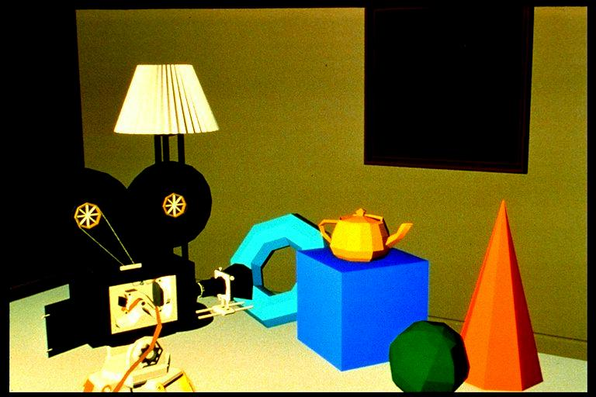
Per-Polygon (Faceted, Flat) Shading
Guess PER POLYGON ? FLAT / SMOOTH ?

Slide 9
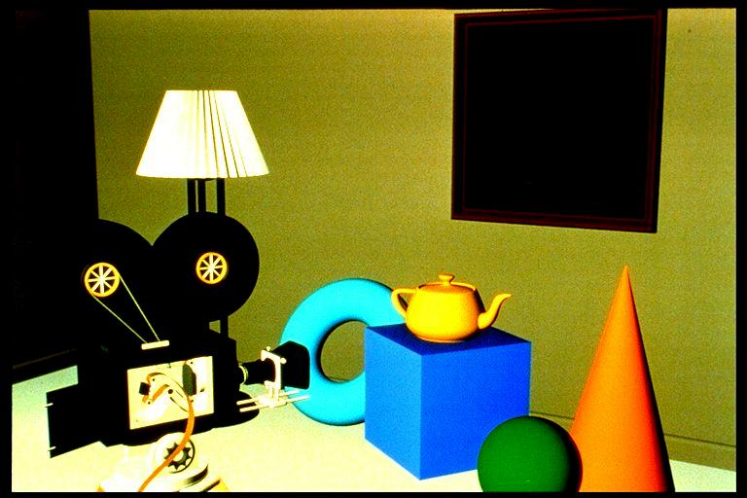
Gouraud Shading
Guess PER POLYGON ? FLAT / SMOOTH ?

Slide 10
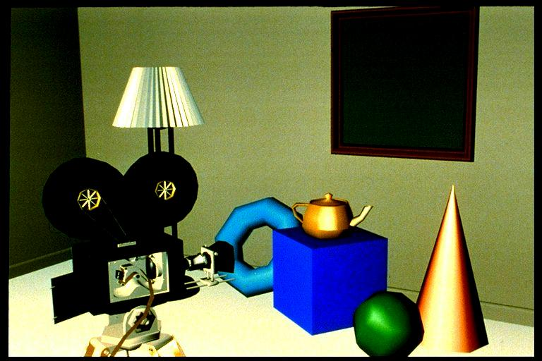
Specular Reflection
Guess specular reflection ?

Slide 11
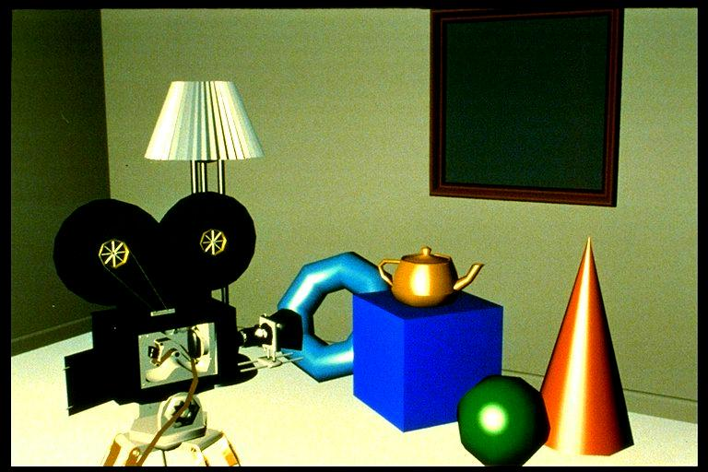
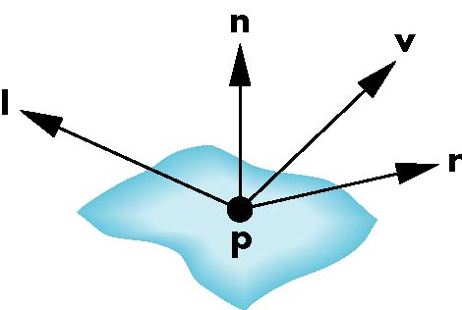
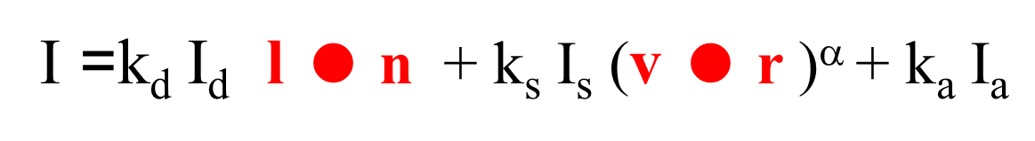
Phong Shading

Slide 12
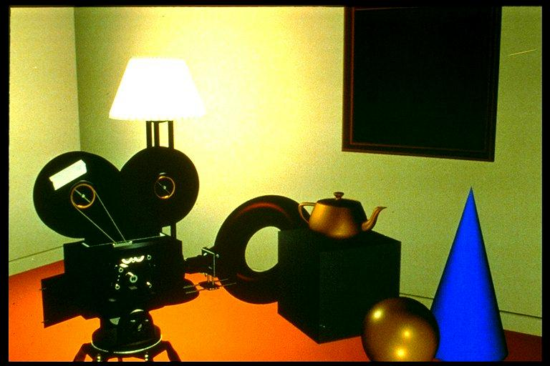
Complex Lighting and Shading

Slide 13
Lighting

Slide 14
Flat vs Smooth Shading
Guess FLAT / SMOOTH ?

Slide 15
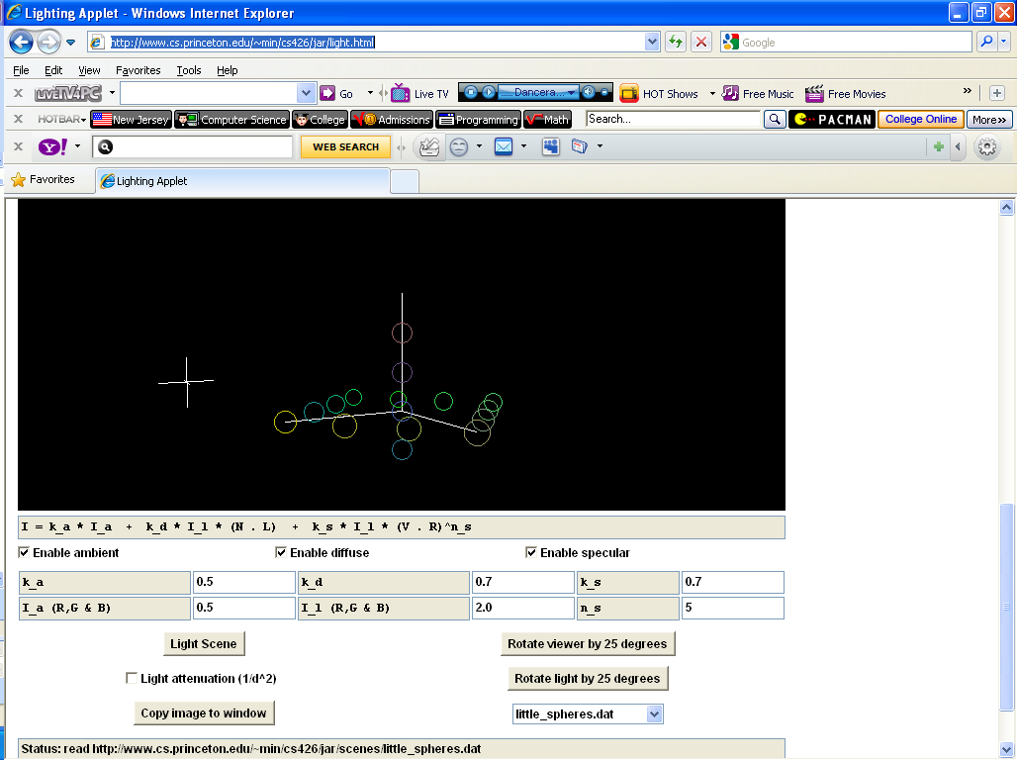
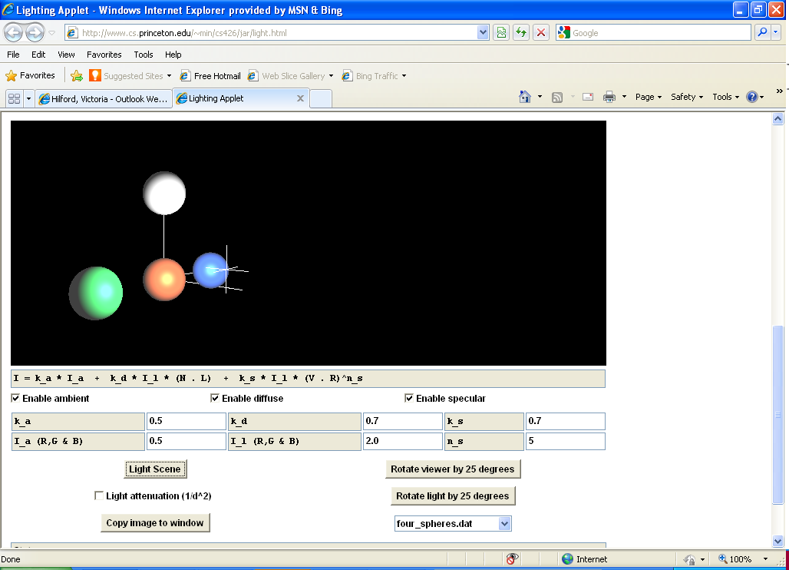
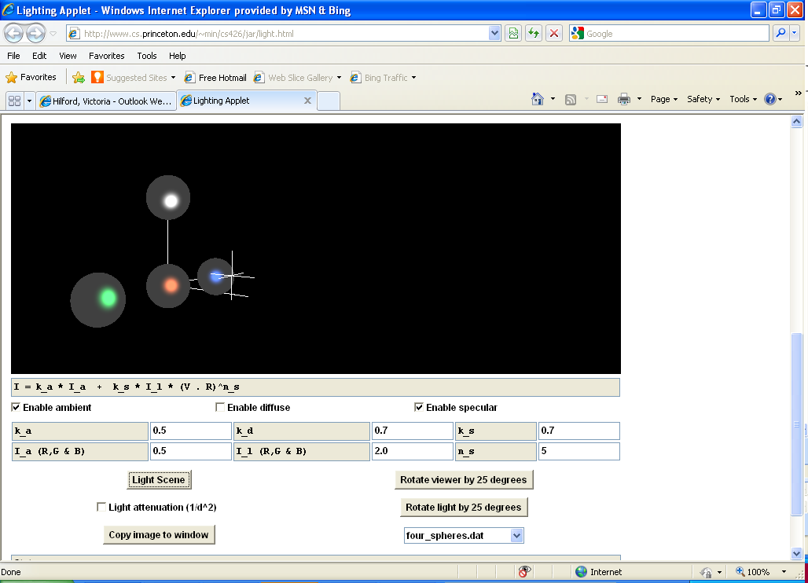
Lighting Applet
15
http://www.cs.princeton.edu/~min/cs426/jar/light.html
Angel: Interactive Computer Graphics 5E © Addison-Wesley 2009

Slide 16
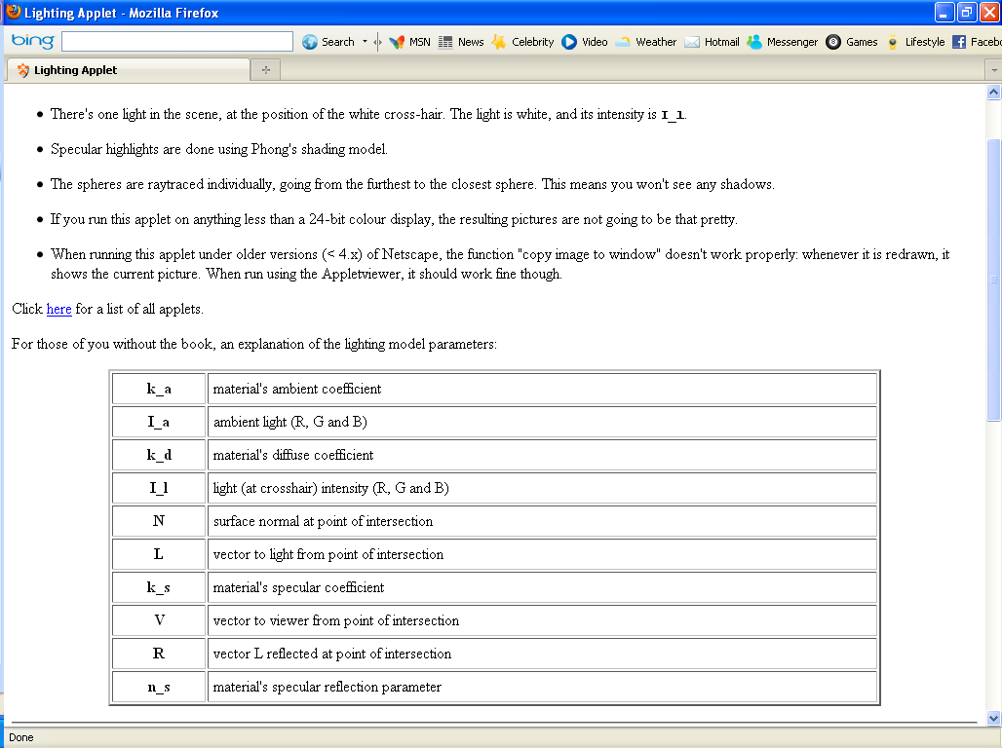

Slide 17
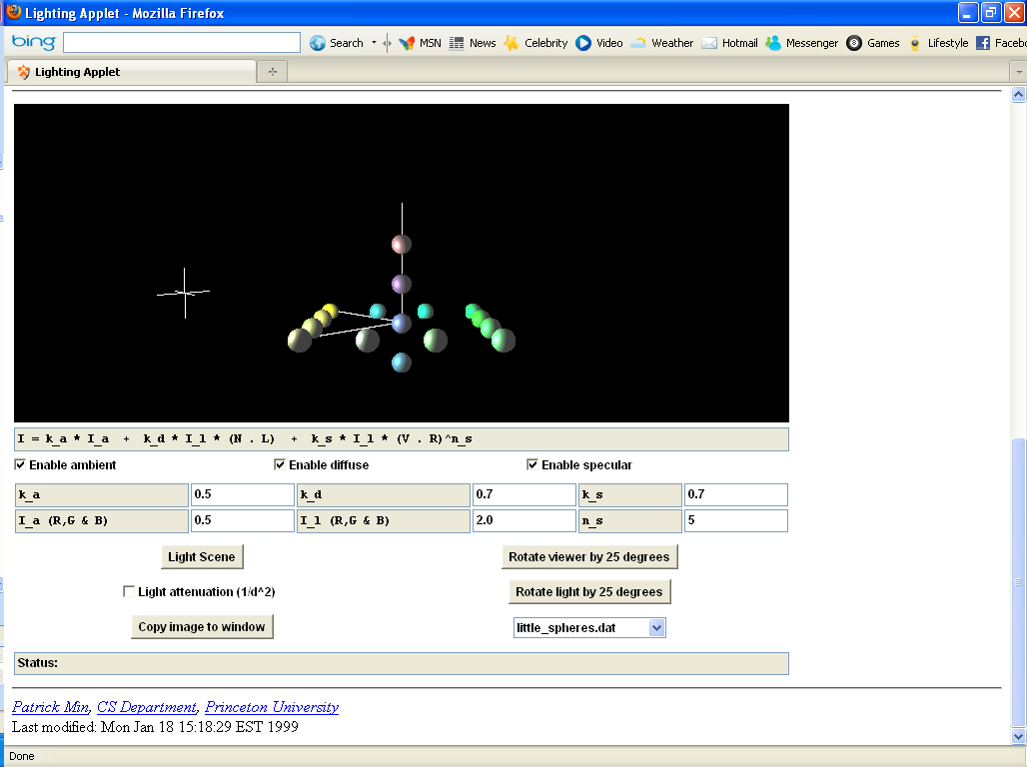

Slide 18
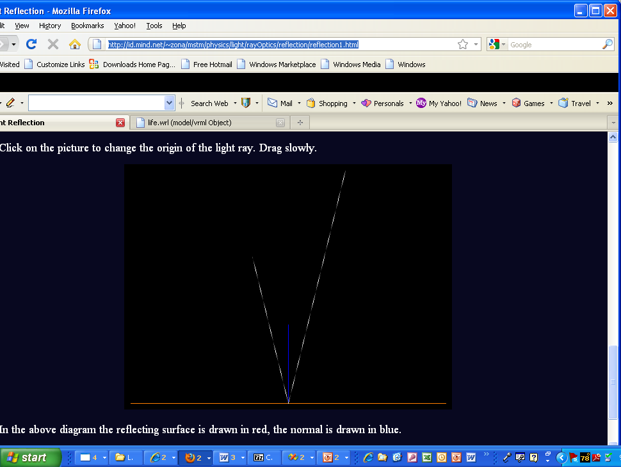
VRML – Light Reflection
Angel: Interactive Computer Graphics 5E © Addison-Wesley 2009
18
http://id.mind.net/~zona/mstm/physics/light/rayOptics/reflection/reflection1.html

Slide 19
Shading I
http://www.3dengines.de/feat_phong.html
Angel: Interactive Computer Graphics 5E © Addison-Wesley 2009
19

Slide 20
Objectives
Learn to shade objects so their images appear three-dimensional
Introduce the types of light-material interactions
Build a simple reflection model---the Phong model - can be used with real time graphics hardware
20
Notes:
6.1 LIGHT AND MATTER In Chapters 1 and 2, we presented the rudiments of human color vision, delaying until now any discussion of the interaction between light and surfaces. Perhaps the most general approach to rendering is based on physics, where we use principles such as conservation of energy to derive equations that describe how light interacts with materials. From a physical perspective, a surface can either emit light by self- emission, as a light bulb does, or reflect light from other surfaces that illuminate it. Some surfaces may both reflect light and emit light from internal physical processes. When we look at a point on an object, the color that we see is determined by multiple interactions among light sources and reflective surfaces. These interactions can be viewed as a re-cursive process. Consider the simple scene illustrated in Figure 6.1. Some light from the source that reaches surface A is scattered. Some of this reflected light reaches sur-face B, and some of it is then scattered back to A, where some of it is again reflected back to B, and so on. This recursive scattering of light between surfaces accounts for subtle shading effects, such as the bleeding of colors between adjacent surfaces. Mathematically, this recursive process results in an integral equation, the rendering equation, which in principle we could use to find the shading of all surfaces in a scene. Unfortunately, this equation generally cannot be solved analytically. Numerical methods are not fast enough for real- time rendering. There are various approximate approaches, such as radiosity and ray tracing, each of which is an excellent approx-imation to the rendering equation for particular types of surfaces. Unfortunately, neither ray tracing nor radiosity can yet be used to render scenes at the rate at which we can pass polygons through the modeling- projection pipeline. Consequently, we Because we only need to consider light that enters the camera by passing through the center of projection, we can start at the center of projection and follow a projec-tor though each pixel in the clipping window. If we assume that all our surfaces are opaque, then the color of the first surface intersected along each projector determines the color of the corresponding pixel in the frame buffer. Note that most rays leaving a light source do not contribute to the image and are thus of no interest to us. Hence, by starting at the center of projection and casting rays we have the start of an efficient ray tracing method, one that we explore further in Section 6.10 and Chapter 13.

Slide 21
Objectives
Learn to shade objects so their images appear three-dimensional
Introduce the types of light-material interactions
Build a simple reflection model---the Phong model--- that can be used with real time graphics hardware
21

Slide 22
Why we need shading
Suppose we build a model of a sphere using many polygons and color it with glColor. We get something like
But we want
22

Slide 23
Shading
Why does the image of a real sphere look like
Light-material interactions cause each point P to have a different color or shade
Need to consider vectors
Light source(s) l
Material properties r
Location of viewer v
Surface orientation P → n
P
23

Slide 24
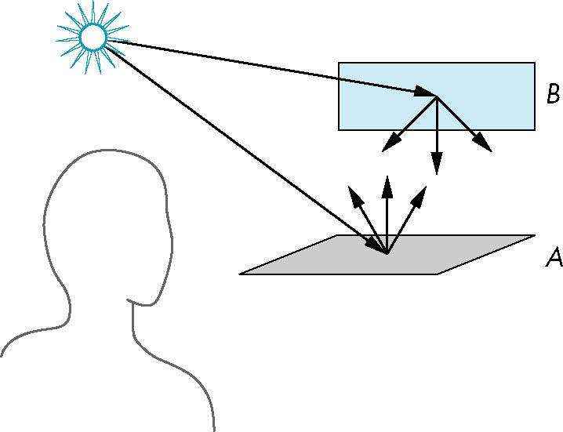
Scattering
Light strikes A
Some scattered
Some absorbed
Some of scattered light strikes B
Some scattered
Some absorbed
Some of this scattered
light strikes A
and so on
B
A
24

Slide 25
Rendering Equation
The infinite scattering and absorption of light can be described by the rendering equation
(Bidirectional Reflection Distribution Function ( BRDF))
Cannot be solved in general
Ray tracing is a special case for perfectly reflecting surfaces
Rendering equation is global and includes
Shadows
Multiple scattering from object to object
25

Slide 26
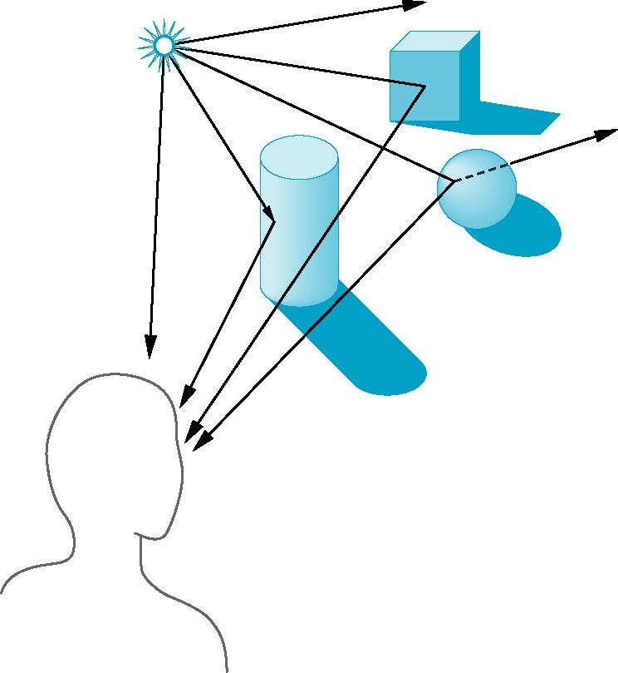
Global Effects
shadow
multiple reflection
translucent surface
26
Notes:
Figure 6.2 shows both single and multiple interactions between rays and objects. It is the nature of these interactions that determines whether an object appears red or brown, light or dark, dull or shiny. When light strikes a surface, some of it is absorbed and some of it is reflected. If the surface is opaque, reflection and absorption account for all the light striking the surface. If the surface is translucent, some of the light is transmitted through the material and emerges to interact with other objects. These interactions depend on the wavelength of the light. An object illuminated by white light appears red because it absorbs most of the incident light but reflects light in the red range of frequencies. A shiny object appears so because its surface is smooth. Conversely, a dull object has a rough surface. The shading of objects also depends on the orientation of their surfaces, a factor that we will see is characterized by the normal vector at each point.

Slide 27
Local vs Global Rendering
Correct shading requires a global calculation involving all objects and light sources
Incompatible with pipeline model which shades each polygon independently (local rendering)
However, in computer graphics, especially real time graphics, we are happy if things “look right”
Exist many techniques for approximating global effects
27

Slide 28
Objectives
Learn to shade objects so their images appear three-dimensional
Introduce the types of light-material interactions
Build a simple reflection model---the Phong model--- that can be used with real time graphics hardware
28
Notes:
Figure 6.2 shows both single and multiple interactions between rays and objects. It is the nature of these interactions that determines whether an object appears red or brown, light or dark, dull or shiny. When light strikes a surface, some of it is absorbed and some of it is reflected. If the surface is opaque, reflection and absorption account for all the light striking the surface. If the surface is translucent, some of the light is transmitted through the material and emerges to interact with other objects. These interactions depend on the wavelength of the light. An object illuminated by white light appears red because it absorbs most of the incident light but reflects light in the red range of frequencies. A shiny object appears so because its surface is smooth. Conversely, a dull object has a rough surface. The shading of objects also depends on the orientation of their surfaces, a factor that we will see is characterized by the normal vector at each point.
These interactions between light and materials can be classified into the three groups depicted in Figure 6.4. 1. Specular surfaces appear shiny because most of the light that is reflected or scattered is in a narrow range of angles close to the angle of reflection. Mirrors are perfectly specular surfaces; the light from an incoming light ray may be partially absorbed, but all reflected light emerges at a single angle, obeying the rule that the angle of incidence is equal to the angle of reflection.

Slide 29
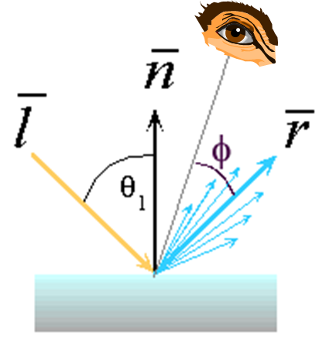
Light-Material Interaction
Light that strikes an object is partially absorbed and partially scattered (reflected)
The amount reflected determines the color and brightness of the object
A surface appears red under white light because the red component of the light is reflected and the rest is absorbed
The reflected light is scattered (diffuse) in a manner that depends on the smoothness and orientation of the surface (n)
29
http://www.walter-fendt.de/ph14e/refraction.htm

Slide 30
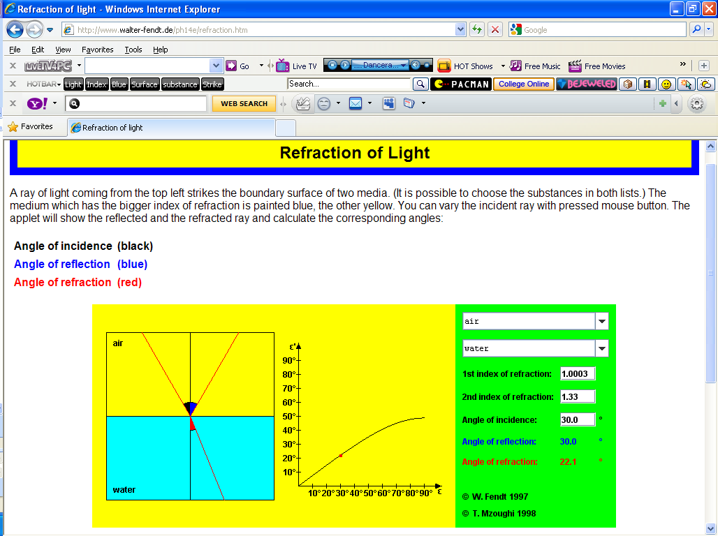
Refraction of Light Applet
30
http://www.walter-fendt.de/ph14e/refraction.htm
Angel: Interactive Computer Graphics 5E © Addison-Wesley 2009

Slide 31
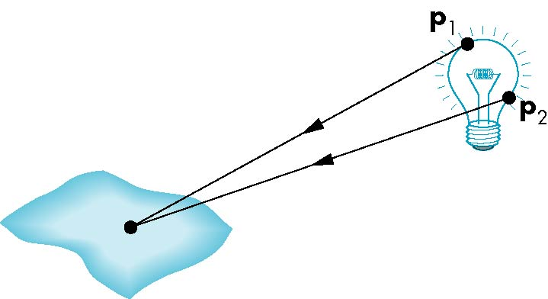
Light Sources
General light sources are difficult to work with because we must integrate light coming from all points on the source
31
Notes:
Not only do light sources emit different amounts of light at different frequencies, but their directional properties can vary with frequency. Consequently, a physically correct model can be complex. However, our model of the human visual system is based on three- color theory that tells us we perceive three tristimulus values, rather than a full color distribution. For most applications, we can thus model light sources as having three components red, green, and blue and can use each of the three color sources to obtain the corresponding color component that a human observer sees. Thus, we can describe a color source through a three- component intensity or illumination function L = ( Lr , Lg , Lb), each of whose components is the intensity of the independent red, green, and blue components. Thus, we use the red component of a light source for the calculation of the red component of the image. Because light material computations involve three similar but independent calculations, we tend to present a single scalar equation, with the understanding that it can represent any of the three color components. Rather than write what will turn out to be identical expressions for each component of L, we will use the the scalar L to denote any of the its components. That is, L . { Lr , Lg , Lb}.

Slide 32
Light Sources
directional/parallel lights
point at infinity: (x,y,z,0)^{T}
point lights
finite position: (x,y,z,1)^{T}
spotlights
position, direction, angle
ambient lights

Slide 33
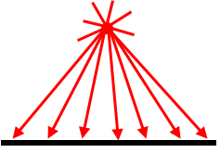
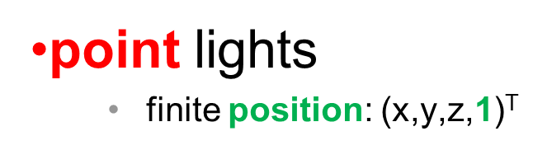
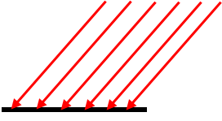
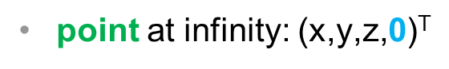
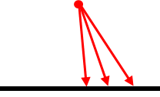

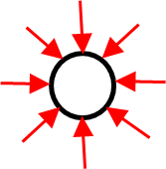
Simple Light Sources
Point source
Model with position and color
Distant source = infinite distance away (parallel)
Spotlight
Restrict light from ideal point source
Ambient light
Same amount of light everywhere in scene
Can model contribution of many sources and reflecting surfaces
33
Notes:
6.2.3 Point Sources An ideal point source emits light equally in all directions. We can characterize a point source located at a point p0 by a three- component color function L( p0) = ( Lr( p0), Lg( p0), Lb( p0)). We use L( p0) to refer to any of the components. The intensity of illumination received from a point source located at p0 at a point p is proportional to the inverse square of the distance from the source. Hence, at a point p ( Figure 6.7), any component of the intensity of light received from the point source is given by function of the form L( p, p0) = 1 | p - p0| 2 L( p0). The use of point sources in most applications is determined more by their ease of use than by their resemblance to physical reality. Scenes rendered with only point sources tend to have high contrast; objects appear either bright or dark. In the real world, it is the large size of most light sources that contributes to softer scenes, as we can see from Figure 6.8, which shows the shadows created by a source of finite size. Some areas are fully in shadow, or in the umbra, whereas others are in partial shadow, or in the penumbra. We can mitigate the high- contrast effect from point-source illumination by adding ambient light to a scene. The distance term also contributes to the harsh renderings with point sources. Although the inverse- square distance term is correct for point sources, in practice it is usually replaced by a term of the form ( a + bd + cd2)- 1, where d is the distance between p and p0. The constants a, b, and c can be chosen to soften the lighting. In addition, a small amount of ambient light also softens the effect of point sources. Note that if the light source is far from the surfaces in the scene, then the intensity of the light from the source is sufficiently uniform that the distance term is almost constant over the surfaces.

Slide 34
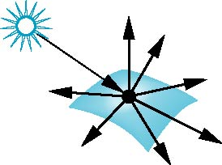
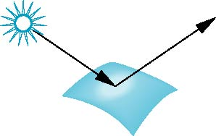
Surface Types
The smoother a surface, the more reflected light is concentrated in the direction a perfect mirror would reflect the light - specular
A very rough surface scatters light in all directions-diffuse
Specular reflections
Diffuse reflections
smooth surface
rough surface
34

Slide 35
Objectives
Learn to shade objects so their images appear three-dimensional
Introduce the types of light-material interactions
Build a simple reflection model---the Phong model--- that can be used with real time graphics hardware
35

Slide 36
Lighting vs. Shading
lighting
simulating the interaction of light with surface
shading
deciding pixel color
continuum of realism: when do we do lighting calculation?

Slide 37
Shading Models
flat shading
compute Phong lighting once for entire polygon
Gouraud shading
compute Phong lighting at the vertices and interpolate lighting values across polygon
Phong shading
compute averaged vertex normals
interpolate normals across polygon and perform Phong lighting across polygon

Slide 38
Phong Model
A simple model that can be computed rapidly
Has three components
Ambient
Diffuse
Specular
Uses four vectors
To source l
To viewer v
Normal n
Perfect reflector r
38
http://www.cs.princeton.edu/~min/cs426/classes/light.html
Notes:
The lighting model that we present was introduced by Phong and later modified by Blinn. It has proved to be efficient and to be a close enough approximation to physical reality to produce good renderings under a variety of lighting conditions and material properties. The Phong- Blinn or ( modified Phong) model is the basis for lighting and shading in graphics APIs and is implemented on virtually all graphics cards. The Phong lighting model uses the four vectors shown in Figure 6.13 to calculate a color for an arbitrary point p on a surface. If the surface is curved, all four vectors can change as we move from point to point. The vector n is the normal at p; we discuss its calculation in Section 6.4. The vector v is in the direction from p to the viewer or COP. The vector l is in the direction of a line from p to an arbitrary point on the source for a distributed light source or, as we are assuming for now, to the point- light source. Finally, the vector r is in the direction that a perfectly reflected ray from l would take. Note that r is determined by n and l. We calculate it in Section 6.4. The Phong model supports the three types of light material interactions ambient, diffuse, and specular that we introduced in Section 6.1. Suppose that we have a set of point sources. Each source can have separate ambient, diffuse, and spec-ular components for each of the three primary colors. From a physical perspective it may appear somewhat strange that a light source has three independent colors for each of the three types of lighting. However, remem-ber that our goal is to create realistic shading effects in as close to real time as possible, rather than trying to model the BRDF as accurately as possible. Hence, we use tricks with a local model to simulate effects that can be global in nature. The ambient source color represents the the interaction of a light source with the surfaces in the environment whereas the the specular source color is designed to produce the desired color of a specular highlight.
Thus, if our light- source model has separate ambient, diffuse, and specular terms, we need nine coefficients to characterize a light source at any point p on the surface. We can place these nine coefficients in a 3 3 illumination array for the ith light source:
1. Specular surfaces appear shiny because most of the light that is reflected or scattered is in a narrow range of angles close to the angle of reflection. Mirrors are perfectly specular surfaces; the light from an incoming light ray may be partially absorbed, but all reflected light emerges at a single angle, obeying the rule that the angle of incidence is equal to the angle of reflection.
2. Diffuse surfaces are characterized by reflected light being scattered in all directions. Walls painted with matte or flat paint are diffuse reflectors, as are many natural materials, such as terrain viewed from an airplane or a satellite. Perfectly diffuse surfaces scatter light equally in all directions and thus appear the same to all viewers.
3. Translucent surfaces allow some light to penetrate the surface and to emerge from another location on the object. This process of refraction characterizes glass and water. Some incident light may also be reflected at the surface.
From a physical perspective, the reflection, absorption, and transmission of light at the surface of a material is described by a single function called the Bidirectional Reflection Distribution Function ( BRDF). Consider a point on a surface. Light energy potentially can arrive at this location from any direction and be reflected and leave in any direction. Thus, for every pair of input and output directions, there will be a value that is the fraction of the incoming light that is reflected in the output direction. The BDRF is a function of five variables: the frequency of light, the two angles required to describe the direction of the input vector, and the two angles required to describe the direction of the output vector. For a perfectly diffuse surface, the BDRF is simplified because it will have the same value for all possible output vectors. For a perfect reflector, the BRDF will only be nonzero when the angle of incidence is equal to the angle of reflection. A real physical surface is never perfectly diffuse nor perfectly specular. Although we could approach light material interactions by modeling the BDRF for materials of interest, the subject is not only complex but does not lead to efficient computational models. Instead, we use models that lead to fast computations, especially when we employ them in a pipeline architecture. These models are based on adding together the contributions of simple models of diffuse, specular, and ambient reflections and, if necessary, accounting for transmission. We

Slide 39
NVIDIA & ATI GPUs Graphics in REAL-TIME

Slide 40
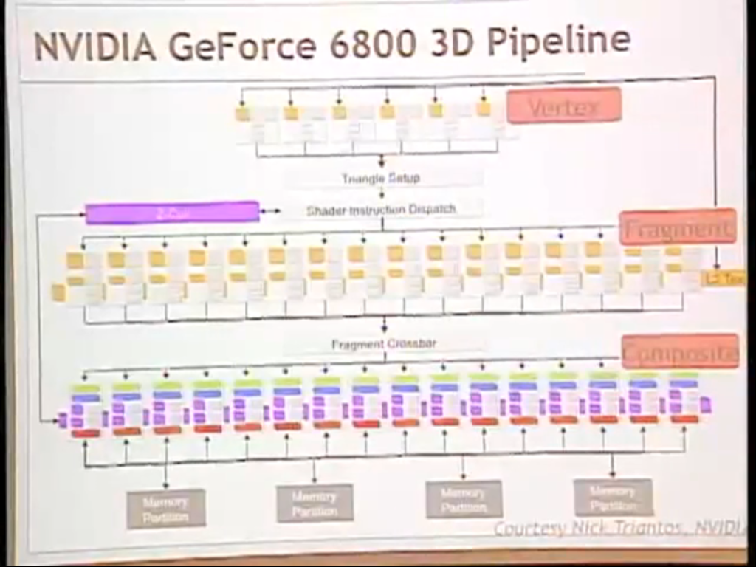
NVIDIA 6800 GPU - PROGRAMMABLE

Slide 41
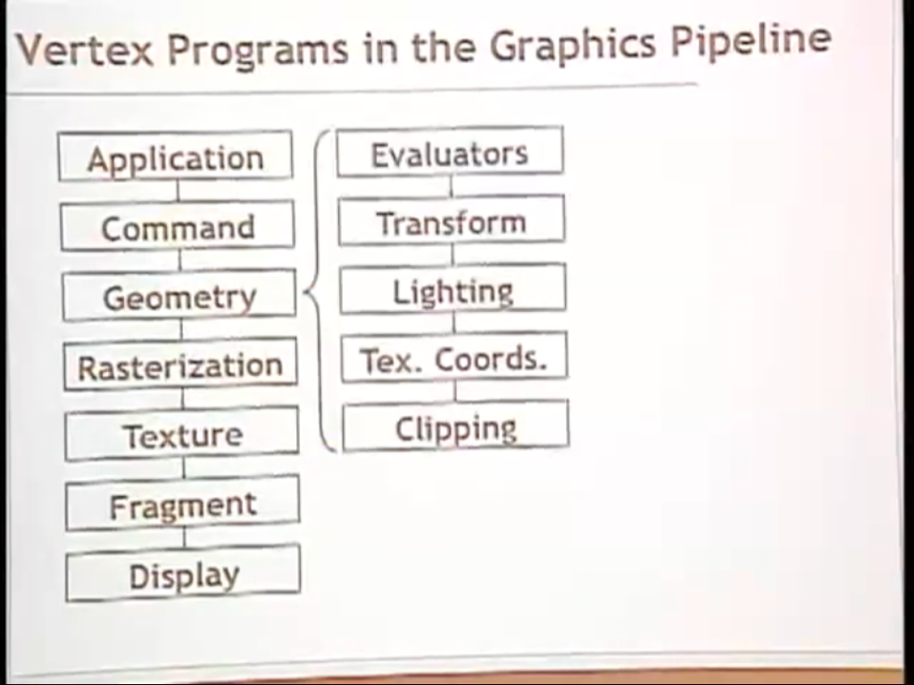

Slide 42
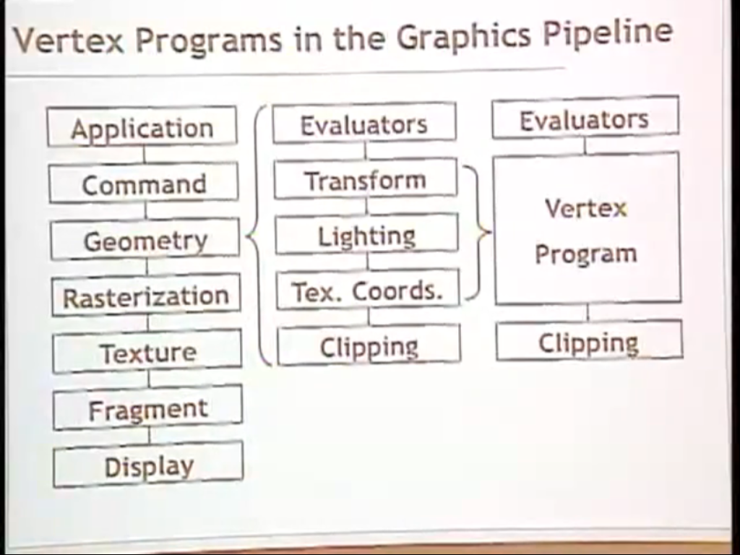

Slide 43
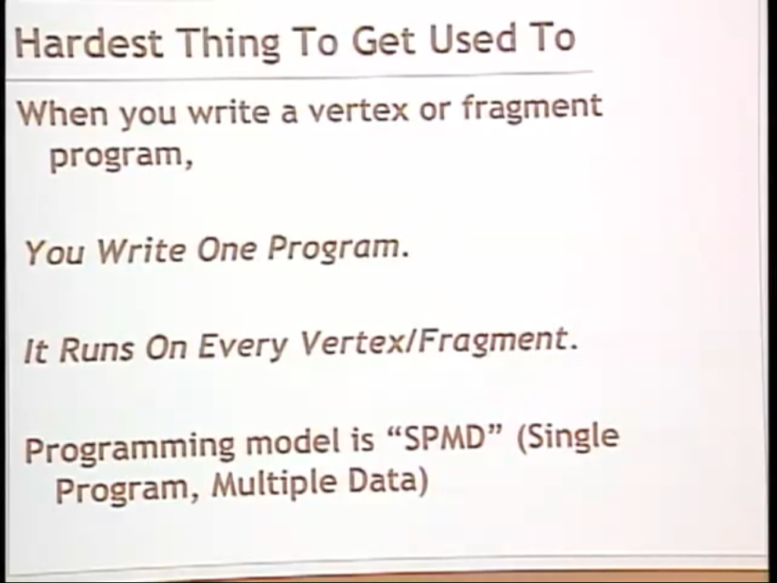

Slide 44
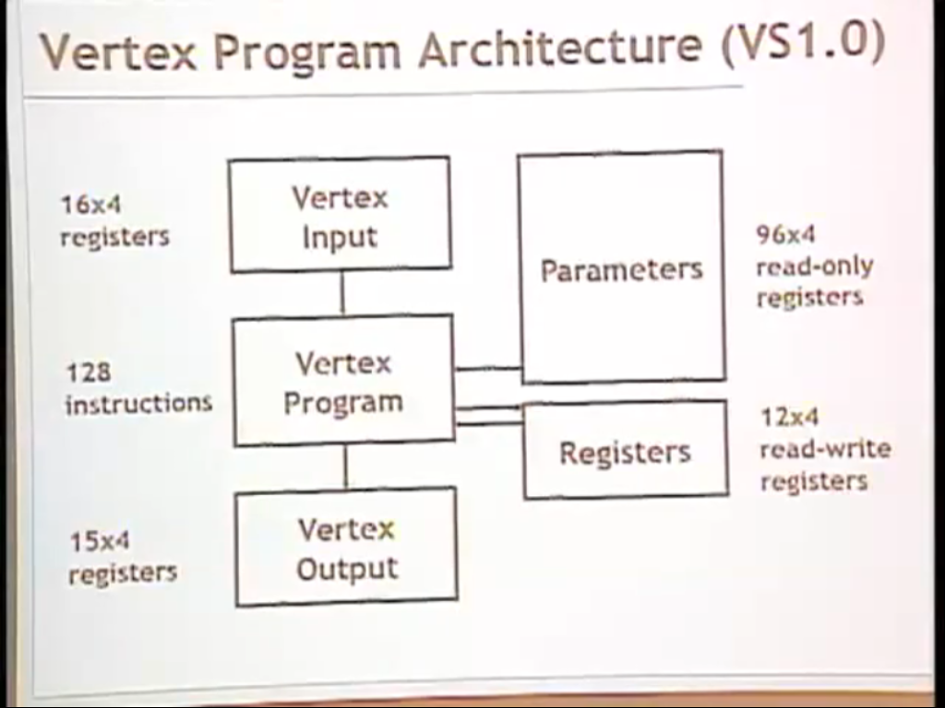
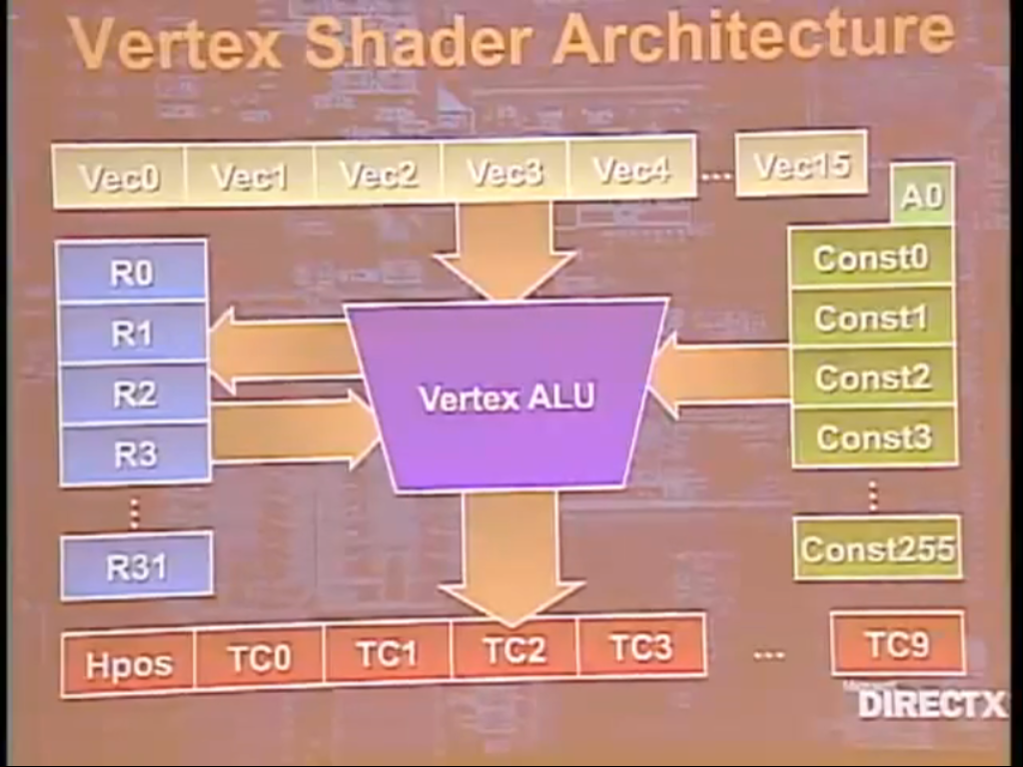

Slide 45
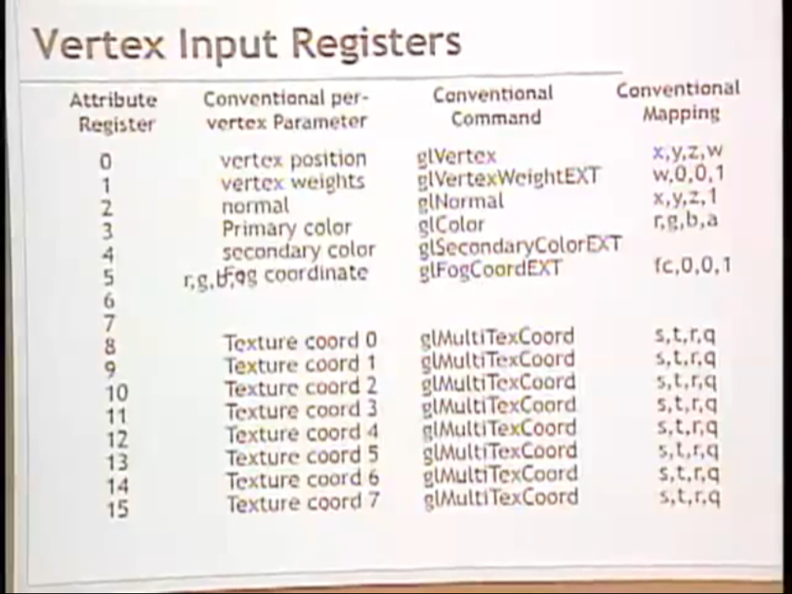
(16)

Slide 46
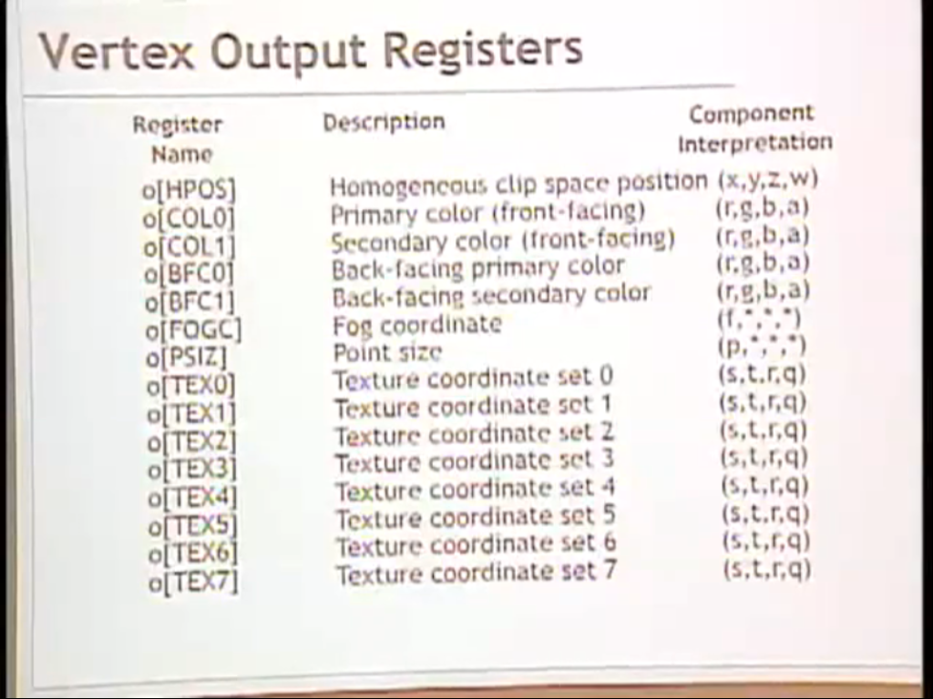
(16)

Slide 47
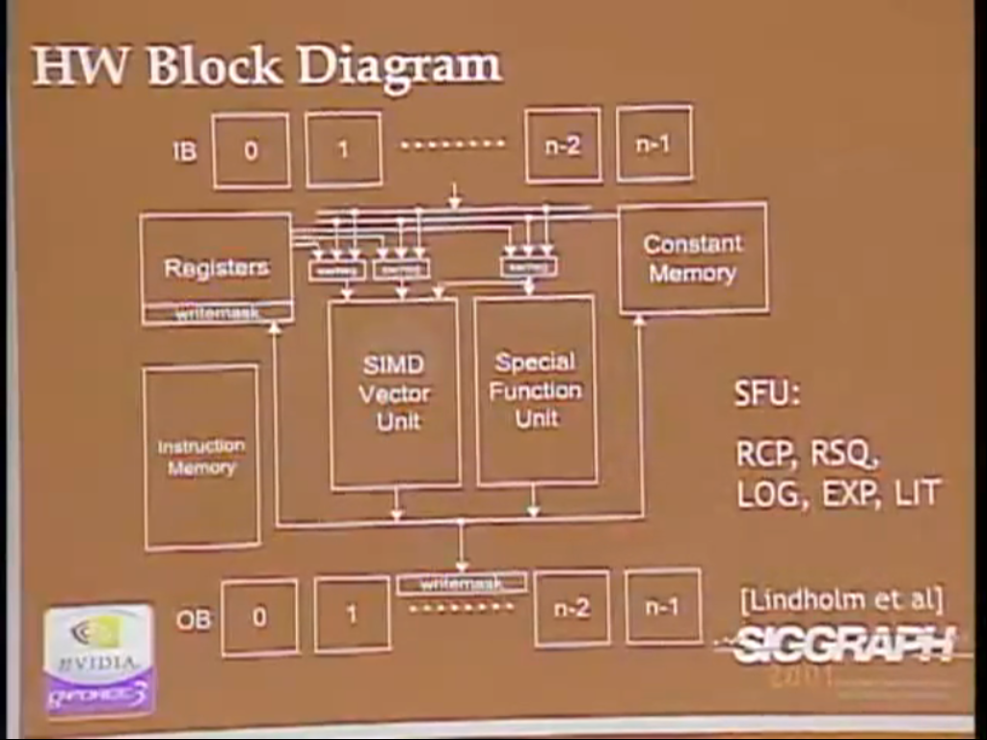
State Machine
Light parameters
Material Properties
Texture
Normals
ModelView Matrix
Projection Matrix
Color
32 bits
128 bits

Slide 48
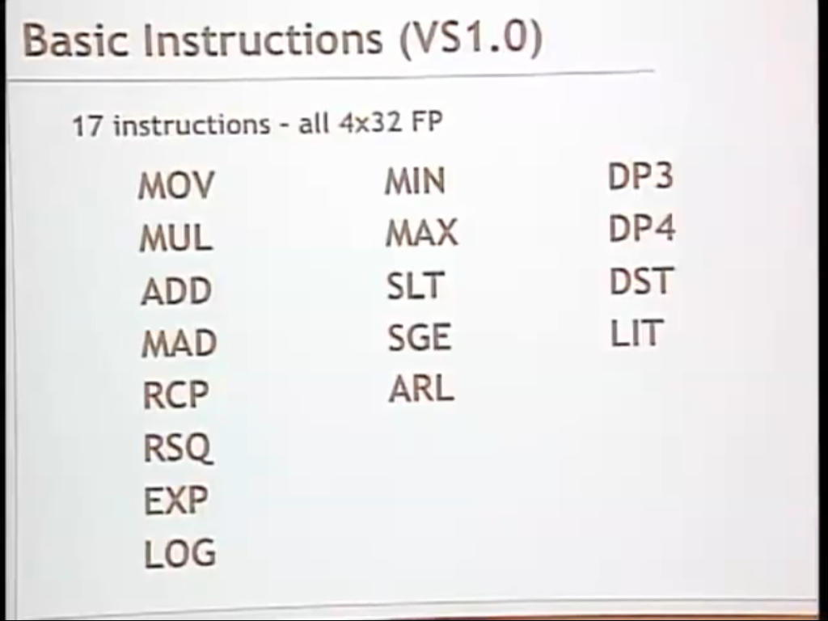
Notes:
NO SUB!
MOV copy from register to register
MAD Multiply and Add
DP3 Dot Product
DST distance (Pythagorean distance between two vectors)
MIN, MAX
ARL addressing instruction
LIT CISC to the nth power; entire blend lighting model that is part of OPENGL. There are 5 components, specular, difuse component and a lot of dot products. The most special purpose instruction that you heard about it.

Slide 49
Instruction Set
NO SUB!
MOV copy from register to register
MAD Multiply and Add
Reciprocal, Reciprocal Square Root (Normals)
DP3 Dot Product
DST distance (Pythagorean distance between two vectors)
MIN, MAX
ARL addressing instruction
LIT CISC to the n^{th} power; entire blend lighting model that is part of OPENGL. There are 5 components, specular, diffuse, ambient components and a lot of dot products. The most special purpose instruction that you heard about it.
No branching!

Slide 50
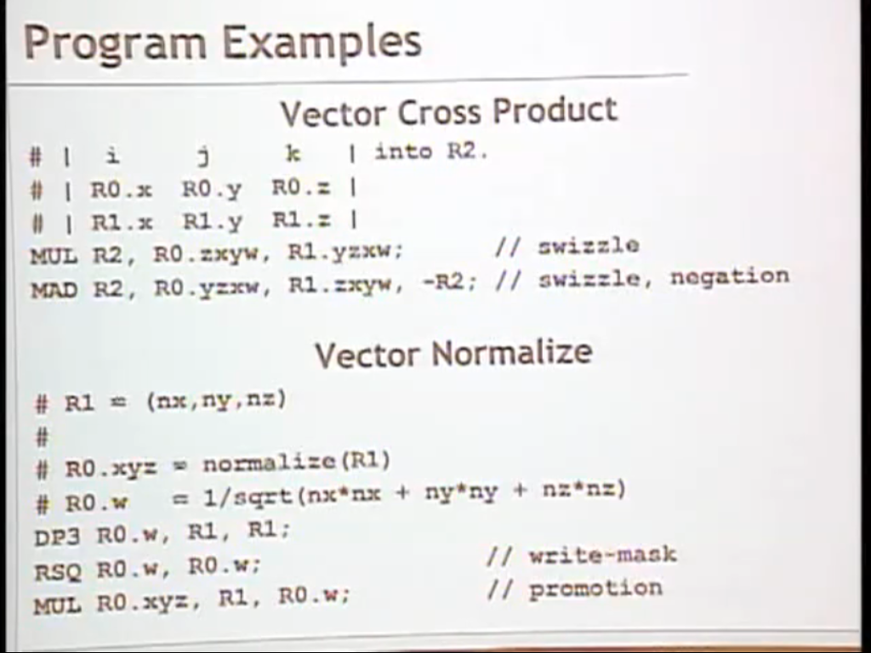

Slide 51
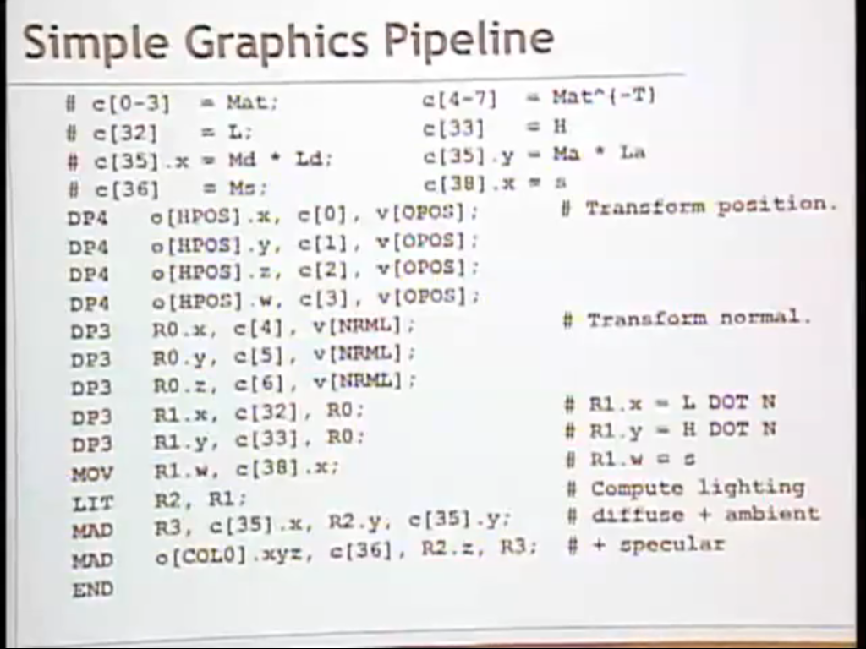
h
Vertex IN Vertex OUT
h

Slide 52
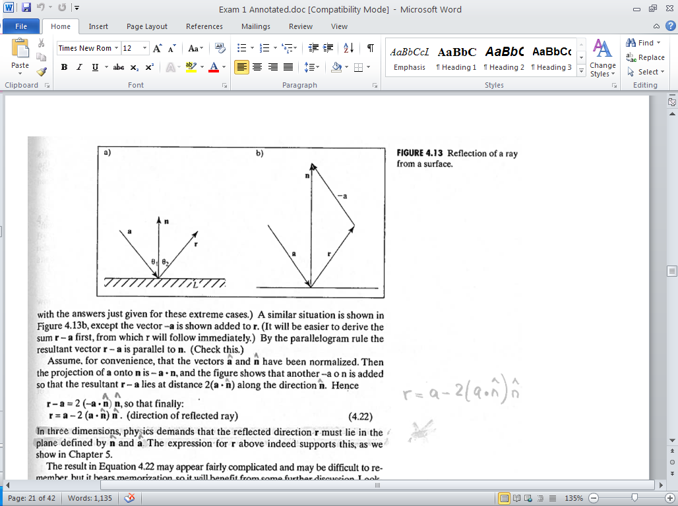
Ideal Reflector r
Normal vector n is determined by local orientation
angle of incidence = angle of reflection
The three vectors must be coplanar
n is normalized; |n| = 1
^
(a ● n ) scalar
n
^
^
(a ● n ) n vector
Parallelogram rule
^
^
^
^
r = a - 2(a ● n ) n
r – a = 2 (-a ● n ) n
52

Slide 53
Ideal Reflector r
^
^
r = a - 2(a ● n ) n
n
Let a = (4, -2) and n = (0, 3). What is r?
^
Normalize n
n = (0, 1)
r = (4, -2) – 2 ((4, -2) (0, 1)) (0, 1) = (4, -2) -2(-2) (0,1) = (4, -2) – (0, -4) = (4, 2)
53

Slide 54
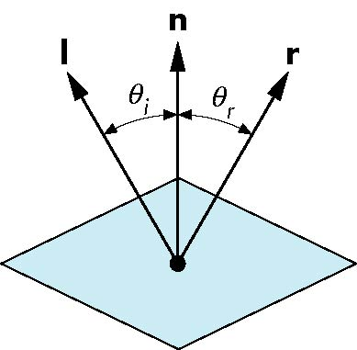
Ideal Reflector r
Normal vector n is determined by local orientation
angle of incidence = angle of reflection
The three vectors must be coplanar
r = 2 (l ● n ) n - l
CLASS PARTICIPATION 1!
(Next Slide)
54

Slide 55

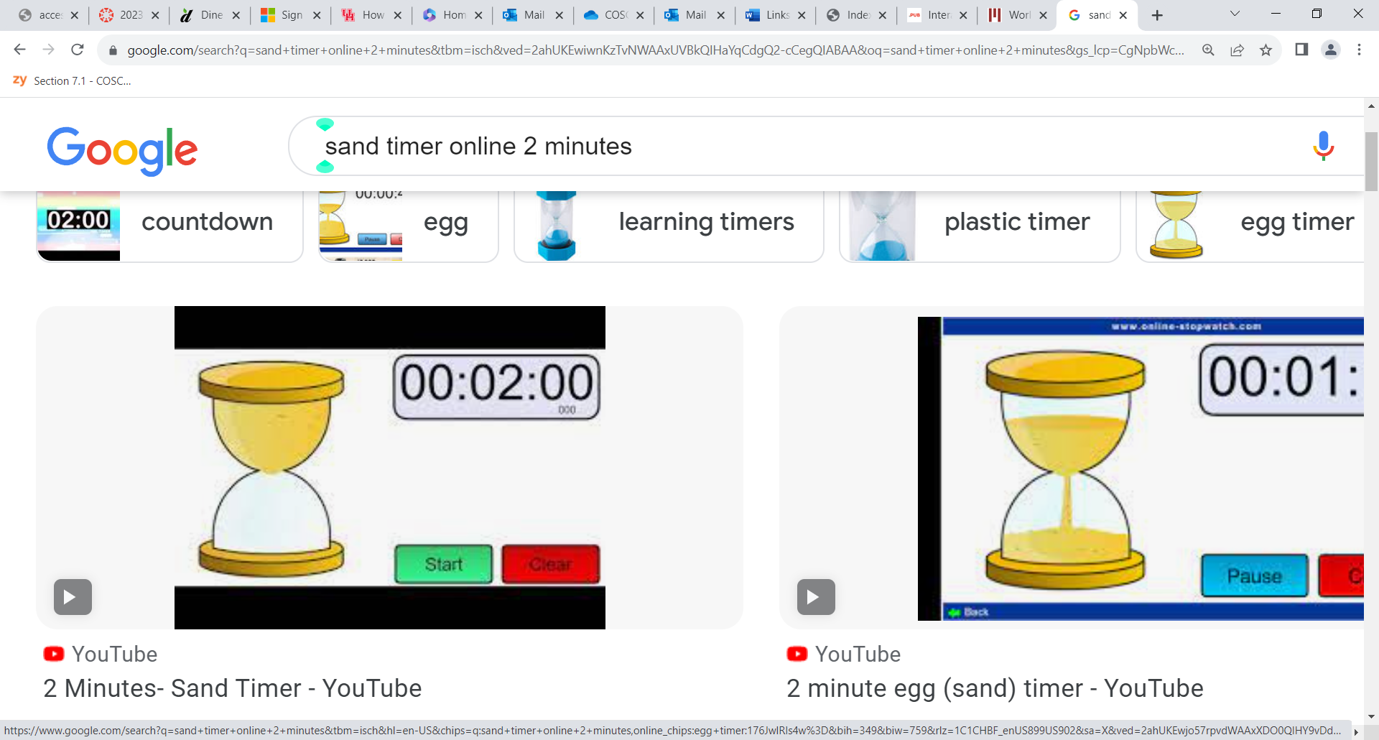
Self Graded - correctly

Slide 56
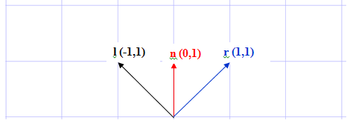
Ideal Reflector r
r = 2 (l ● n ) n - l
56

Slide 57
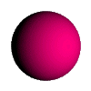
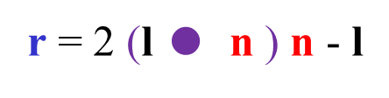
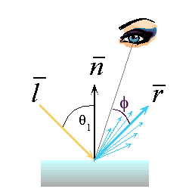
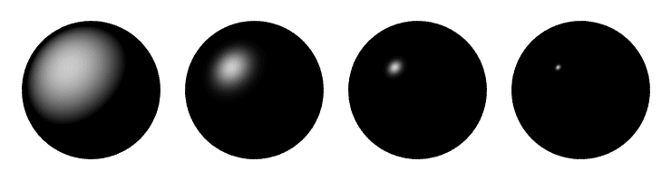
Reflection Equations
l
n
I_{diffuse} = k_{d} I_{light} (n • l)
θ
•

Slide 58
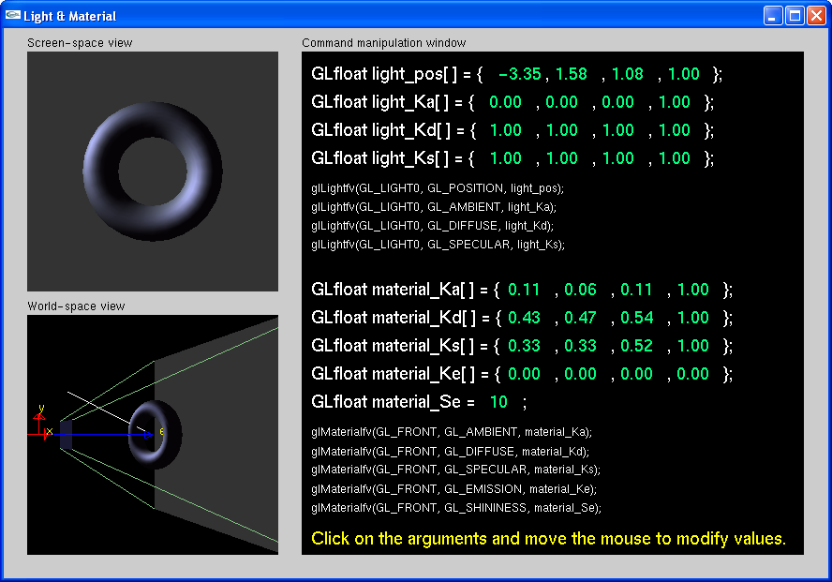
LIGHT MATERIAL DEMO!
KINGSTON:\COSC 4370 SUMMER 2010\NATE ROBINS OPENGL TUTORIALS\tutors\lightmaterial.exe

Slide 59
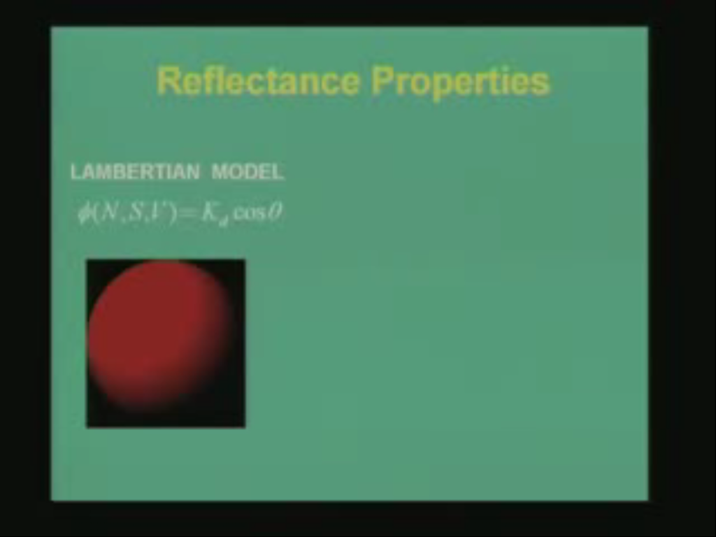
Diffuse

Slide 60
Lambertian Surface
?????
Perfectly diffuse reflector
Light scattered equally in all directions
Amount of light reflected is proportional to the vertical component of incoming light l
reflected light ~cos θ_{i}
cos θ_{i} = l ● n if vectors normalized
There are also three coefficients, k_{r}, k_{b}, k_{g} that show how much of each color component is reflected
60
Notes:
A perfectly diffuse reflector scatters the light that it reflects equally in all directions. Hence, such a surface appears the same to all viewers. However, the amount of light reflected depends both on the material because some of the incoming light is absorbed and on the position of the light source relative to the surface. Diffuse reflections are characterized by rough surfaces. If we were to magnify a cross section of a diffuse surface, we might see an image like that shown in Figure 6.14. Rays of light that hit the surface at only slightly different angles are reflected back at markedly different angles. Perfectly diffuse surfaces are so rough that there is no preferred angle of reflection. Such surfaces, sometimes called Lambertian surfaces, can be modeled mathematically with Lamberts law. Consider a diffuse planar surface, as shown in Figure 6.15, illuminated by the sun. The surface is brightest at noon and dimmest at dawn and dusk because, ac-cording to Lamberts law, we see only the vertical component of the incoming light. One way to understand this law is to consider a small parallel light source striking a plane, as shown in Figure 6.16. As the source is lowered in the ( artificial) sky, the same amount of light is spread over a larger area, and the surface appears dimmer. Returning to the point source of Figure 6.15, we can characterize diffuse reflections mathematically. Lamberts law states that Rd . cos . , where . is the angle between the normal at the point of interest n and the direction of the light source l. If both l and n are unit- length vectors, 3 then cos . = l . n. If we add in a reflection coefficient kd representing the fraction of incoming diffuse light that is reflected, we have the diffuse reflection term: Id = kd( l . n) Ld. If we wish to incorporate a distance term, to account for attenuation as the light travels a distance d from the source to the surface, we can again use the quadratic attenuation term: Id = kd a + bd + cd2 ( l . n) Ld. There is a potential problem with this expression because ( l . n) Ld will be neg-ative if the light source is below the horizon. In this case, we want to use zero rather than a negative value. Hence, in practice we use max(( l . n) Ld, 0).

Slide 61
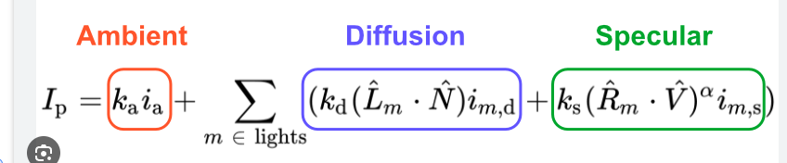

Slide 62

Diffuse
Diffuse & Specular
Diffuse
Diffuse 0.3 & Specular 0.7
Diffuse 0.7 & Specular 0.3

Slide 63

Specular Surfaces
Most surfaces are neither ideal Diffusers nor perfectly Specular (ideal reflectors)
Smooth surfaces show specular highlights due to incoming light being reflected in directions concentrated close to the direction of a perfect reflection
Specular reflections
Diffuse reflections
specular
highlight
smooth surface
63
rough surface
Notes:
If we employ only ambient and diffuse reflections, our images will be shaded and will appear three- dimensional, but all the surfaces will look dull, somewhat like chalk. What we are missing are the highlights that we see reflected from shiny objects. These highlights usually show a color different from the color of the reflected ambient and diffuse light. For example, a red plastic ball viewed under white light has a white highlight that is the reflection of some of the light from the source in the direction of the viewer ( Figure 6.17). Whereas a diffuse surface is rough, a specular surface is smooth. The smoother the surface is, the more it resembles a mirror. Figure 6.18 shows that as the surface gets smoother, the reflected light is concentrated in a smaller range of angles centered FIGURE 6.18 Specular surface.

Slide 64
Modeling Specular Reflections
Phong proposed using a term that dropped off as the angle between the viewer v and the ideal reflection r increased
v
I_{r} ~ k_{s} I cos^{α}φ
φ
r
reflected
intensity
α shininess coef
incoming intensity
absorption coef
64

Slide 65

The Shininess Coefficient
α
Values of α between 100 and 200 correspond to metals
Values between 5 and 10 give surface that look like plastic
cos^{α} φ
-90
φ
90
65
Notes:
about the angle of a perfect reflector a mirror or a perfectly specular surface. Mod-eling specular surfaces realistically can be complex because the pattern by which the light is scattered is not symmetric. It depends on the wavelength of the incident light, and it changes with the reflection angle. Phong proposed an approximate model that can be computed with only a slight increase over the work done for diffuse surfaces. The model adds a term for specular reflection. Hence, we consider the surface as being rough for the diffuse term and smooth for the specular term. The amount of light that the viewer sees depends on the angle f between r, the direction of a perfect reflector, and v, the direction of the viewer. The Phong model uses the equation Is = ksLs cosa f. The coefficient ks ( 0 = ks = 1) is the fraction of the incoming specular light that is reflected. The exponent a is a shininess coefficient. Figure 6.19 shows how, as a is increased, the reflected light is concentrated in a narrower region centered on the angle of a perfect reflector. In the limit, as a goes to infinity, we get a mirror; values in the range 100 to 500 correspond to most metallic surfaces, and smaller values (< 100) correspond to materials that show broad highlights.
The computational advantage of the Phong model is that if we have normalized r and n to unit length, we can again use the dot product, and the specular termbecomes Is = ksLsmax(( r . v) a, 0). We can add a distance term, as we did with diffuse reflections. What is referred to as the Phong model, including the distance term, is written I = 1 a + bd + cd2 ( kdLdmax( l . n, 0) + ksLsmax(( r . v) a, 0)) + kaLa. This formula is computed for each light source and for each primary. It might seem counter intuitive to have a single light source characterized by different amounts of red, green, and blue light for the ambient, diffuse and specular
terms in the lighting model. However, the white highlight we might see on a red ball is the distorted reflection of a light source or perhaps some other bright white object in the environment. To calculate this highlight correctly would require a global rather than local lighting calculation. Because we cannot solve the full rendering equation, we instead use various tricks in an attempt to obtain realistic renderings, one of which is to allow different ambient, specular, and diffuse lighting colors. Consider, for example, an environment with many objects. When we turn on a light, some of that light hits a surface directly. These contributions to the image can be modeled with specular and diffuse components of the source. However, much of the rest of the light from the source is scattered from multiple reflections from other objects and makes a contribution to the light received at the surface under considera-tion. We can approximate this termby having an ambient component associated with the source. The shade that we should assign to this term depends on both the color of the source and the color of the objects in the room an unfortunate consequence of our use of approximate models. To some extent, the same analysis holds for diffuse light. Diffuse light reflects among the surfaces, and the color that we see on a partic-ular surface depends on other surfaces in the environment. Again, by using carefully chosen diffuse and specular components with our light sources, we can approximate a global effect with local calculations.
We have developed the Phong lighting model in object space. The actual lighting calculation, however, can be done in a variety of ways within the pipeline. In OpenGL, the default is to, do the calculations for each vertex in eye coordinates and then interpolate the shades for each fragment later in the pipeline. We must be careful of the effect of the model- view and projection transformations on the vectors used in the model because these transformations can affect the cosine terms in the model ( see Exercise 6.20). Consequently, to make a correct shading calculation, we must either preserve spatial relationships as vertices and vectors pass through the pipeline, perhaps by sending additional information through the pipeline from object space, or go backward through the pipeline to obtain the required shading information.

Slide 66
The Shininess Coefficient
α
α
α
α

Slide 67
Shading II
shading
deciding pixel color
continuum of realism: when do we do lighting calculation?
67

Slide 68
Objectives
Continue discussion of shading
Introduce modified Phong model
Consider computation of required vectors
68
Notes:
First, we consider modeling of light sources.

Slide 69
Ambient Light
Ambient light is the result of multiple interactions between (large) light sources and the objects in the environment
Amount and color depend on both the color of the light(s) and the material properties of the object
Add k_{a} I_{a} to diffuse and specular terms
intensity of ambient light
reflection coef
69
Notes:
The intensity of ambient light Ia is the same at every point on the surface. Some of this light is absorbed and some is reflected. The amount reflected is given by the ambient reflection coefficient, Ra = ka. Because only a positive fraction of the light is reflected, we must have 0 = ka = 1, and thus Ia = kaLa. Here La can be any of the individual light sources, or it can be a global ambient term. A surface has, of course, three ambient coefficients kar, kag, and kab and they can differ. Hence, for example, a sphere appears yellow under white ambient light
6.2.2 Ambient Light In many situations, such as in classrooms or kitchens, the lights have been designed and positioned to provide uniformillumination throughout the room. Often such il-lumination is achieved through large sources that have diffusers whose purpose is to scatter light in all directions. We could create an accurate simulation of such illumina-tion, at least in principle, by modeling all the distributed sources and then integrating the illumination from these sources at each point on a reflecting surface. Making such amodel and rendering a scene with it would be a daunting task for a graphics system, especially one for which real- time performance is desirable. 2 Alternatively, we can look at the desired effect of the sources: to achieve a uniform light level in the room. This uniform lighting is called ambient light. If we follow this second approach, we can postulate an ambient intensity at each point in the environment. Thus, ambient illumination is characterized by an intensity, Ia, that is identical at every point in the scene. Our ambient source has red, green, and blue color components, Lar , Lag , and Lab. We will use the scalar La to denote any one of the three components. Although every point in our scene receives the same illumination from La, each surface can reflect this light differently based on the surfaces properties. Ambient light depends on the color of the the light sources in the environment. For example, a red light bulb in a white room creates red ambient light. Hence, if we turn off the light, the ambient contribution disappears. OpenGL permits us to add a global ambient term, which does not depend on any of the light sources and is reflected from surfaces. The advantage of adding such a term is that there will always be some light in the environment so that objects in the viewing volume that are not blocked by other objects will always appear in the image.

Slide 70
Distance Terms
The light from a point source that reaches a surface is inversely proportional to the square of the distance d² between them
We can add a factor of the
form 1/(ad + bd +cd²) to
the diffuse and specular
terms
The constants a, b, c and linear terms ad and bd soften the effect of the point source
70

Slide 71

LIGHT POSITION DEMO!
KINGSTON:\COSC 4370 SUMMER 2010\NATE ROBINS OPENGL TUTORIALS\tutors\lightposition.exe

Slide 72
Light Sources
In the Phong Model, we add the results from each light source
Each light source has separate diffuse, specular, and ambient terms to allow for maximum flexibility even though this form does not have a physical justification
Separate red, green and blue components
Hence, 9 coefficients for each point source
I_{dr}, I_{dg}, I_{db}, I_{sr}, I_{sg}, I_{sb}, I_{ar}, I_{ag}, I_{ab}
72

Slide 73
Material Properties
Material properties match light source properties
Nine absorption coefficients
k_{dr}, k_{dg}, k_{db}, k_{sr}, k_{sg}, k_{sb}, k_{ar}, k_{ag}, k_{ab}
Shininess coefficient α
73

Slide 74
Adding up the Components
For each light source and each color component, the Phong model can be written (without the distance terms) as
I =k_{d} I_{d} l ● n + k_{s} I_{s} (v ● r )^{α} + k_{a} I_{a}
For each color component
we add contributions from
all sources
74

Slide 75

Modified Phong Model
The specular term in the Phong model is problematic because it requires the calculation of a new reflection vector r and view vector v for each vertex
Blinn suggested an approximation using the halfway vector that is more efficient
75

Slide 76

The Halfway Vector h
h is normalized vector halfway between l and v
h = ( l + v )/ | l + v |
h
l
v
76
Notes:
If we use the Phong model with specular reflections in our rendering, the dot product r . v should be recalculated at every point on the surface. We can obtain a different approximation for the specular term by using the unit vector halfway between the view vector and the light- source vector, the halfway vector h = l + v | l + v| . Note that if the normal is in the direction of the halfway vector, then the maximum reflection from the surface is in the direction of the viewer. Figure 6.20 shows all five vectors. Here we have defined . as the angle between n and h, the halfway angle. When v lies in the same plane as do l, n, and r, we can show ( see Exercise 6.7) that 2. = f.
If we replace r . v with n . h, we avoid calculation of r. However, the halfway angle . is smaller than f, and if we use the same exponent e in ( n . h) e that we used in ( r . v) e, then the size of the specular highlights will be smaller. We can mitigate this problem by replacing the value of the exponent e with a value e so that ( n . h) e is closer to ( r . v) e. It is clear that avoiding recalculation of r is desirable. However, to appreciate fully where savings can be made, you should consider all the cases of flat and curved surfaces, near and far light sources, and near and far viewers ( see Exercise 6.8). When we use the halfway vector in the calculation of the specular term, we are using the Blinn- Phong, or modifiedPhong, shading model. This model is the default in OpenGL and is the one carried out on each vertex as it passes down the pipeline. It is important to keep in mind that both the Phong and Blinn- Phong models were created as computationally feasible approximations to the BRDF rather than as the best physical models. The availability of the programmable pipelines that we study in Chapter 9 has opened the door to better approximations of the BRDF that can be implemented on present hardware. Color Plate 25 shows a group of Utah teapots ( Section 12.10) that have been ren-dered in OpenGL using the modified Phong model. Note that it is only our ability to control material properties that makes the teapots appear different from one another. The various teapots demonstrate how the modified Phong model can create a variety of surface effects, ranging from dull surfaces to highly reflective surfaces that look like metal.

Slide 77
Using the halfway vector h
Replace (v · r )^{α} by (n · h )^{β}
β is chosen to match shininess
Note that halfway angle is half of angle between v and r if vectors are coplanar
Resulting model is known as the modified Phong or Blinn lighting model
Specified in OpenGL standard
77

Slide 78
Reflection Equations
h
n
Blinn improvement
full Phong lighting model
combine ambient, diffuse, specular components
v
l

Slide 79

Example
Only differences in
these teapots are
the parameters
in the modified
Phong model
79

Slide 80

Computation of Vectors
l and v are specified by the application
Can computer r from l and n
Problem is determining n
For simple surfaces n can be determined but how we determine n differs depending on underlying representation of surface
OpenGL leaves determination of normal to application
Exception for GLU quadrics and Bezier surfaces (Chapter 11)
80

Slide 81

Plane Normals
Equation of plane: ax + by + cz + d = 0
We know that plane is determined by three points p₁, p₂, p₃
Normal n can be obtained by ….
81
CLASS PARTICIPATION 2!
(Next Slide)

Slide 82

Self Graded - correctly

Slide 83
Plane Normals
b
a
We know that plane is determined by three points p₁, p₂, p₃ or normal n and p₁
Normal n can be obtained by
a X b
n = (p₂-p₁) × (p₃-p₁)
83

Slide 84

Normal to Sphere
Implicit function f(x,y.z)=0
Normal given by gradient
Sphere f(p)=p·p-1
n = [∂f/∂x, ∂f/∂y, ∂f/∂z]^{T} = p
84

Slide 85
Parametric Form
For sphere
Tangent plane determined by vectors
Normal n given by cross product
x=x(u,v)=cos u sin v
y=y(u,v)=cos u cos v
z= z(u,v)=sin u
∂p/∂u = [∂x/∂u, ∂y/∂u, ∂z/∂u]T
∂p/∂v = [∂x/∂v, ∂y/∂v, ∂z/∂v]T
n = ∂p/∂u × ∂p/∂v
85

Slide 86
General Case
We can compute parametric normals for other simple cases
Quadrics
Parametric polynomial surfaces
Bezier surface patches (Chapter 11)
86

Slide 87

Gourad Shading
For polygonal models, Gouraud proposed we use the average of the normals of the polygons that share the vertex
The advantage is that it is computationally the less expensive, only requiring the evaluation of the intensity equation at the polygon vertices, and then bilinear interpolation of these values for each pixel.
n
n = (n₁+n₂+n₃+n₄)/ |n₁+n₂+n₃+n₄|
87

Slide 88


Slide 89


Slide 90


Slide 91


Slide 92


Slide 93


Slide 94


Slide 95



Slide 96

Phong Shading vs Gouraud Shading
Angel: Interactive Computer Graphics 5E © Addison-Wesley 2009
96
http://www.nbb.cornell.edu/neurobio/land/OldStudentProjects/cs490-95to96/guo/report.html

Slide 97
Shading in OpenGL Chapter 6 .7
97
Notes:
6.7 LIGHT SOURCES IN OPENGL OpenGL supports the four types of light sources point, spotlight, ambient, and distant that we described in Section 6.4 and allows at least eight light sources in a program. Each must be individually specified and enabled. Although there are many parameters that must be specified, they are exactly the parameters required by the modified- Phong lighting model. The OpenGL functions

Slide 98
Objectives
Introduce the OpenGL shading functions
Discuss polygonal shading
Flat
Smooth
Gouraud
98

Slide 99
Steps in OpenGL shading
99
Enable shading and select model
Specify normals
Specify material properties
Specify lights

Slide 100
Normals
In OpenGL the normal vector is part of the state
Set by glNormal*()
glNormal3f(x, y, z);
glNormal3fv(p);
Usually we want to set the normal to have unit length so cosine calculations are correct
Length can be affected by transformations
Note that scaling does not preserved length
glEnable(GL_NORMALIZE) allows for auto normalization at a performance penalty
100

Slide 101

Normal for Triangle
Express n as a dot product ● and cross product ×
n
p₂
p
p₁
Normalize n
p₀
Note that right-hand rule determines outward face
CLASS PARTICIPATION 3, 4!
(Next Slide)

Slide 102

Self Graded - correctly

Slide 103
Normal for Triangle
Express n as a dot product ● and cross product ×
n
plane n ●(p - p₀ ) = 0
p₂
n = (p₂ - p₀ ) ×(p₁ - p₀ )
p
p₁
Normalize n
p₀
^
normalize n ← n/ |n|
Note that right-hand rule determines outward face

Slide 104


Self Graded - correctly

Slide 105



Comparison Constant Shading/ Wire Frame/ Interpolative Shading

Slide 106

Comparison Constant Shading/ Wire Frame/ Interpolative Shading

Slide 107
Enabling Shading
Shading calculations are enabled by
glEnable(GL_LIGHTING)
Once lighting is enabled, glColor() ignored
Must enable each light source individually
glEnable(GL_LIGHTi) i=0,1…..
Can choose light model parameters
glLightModeli(parameter, GL_TRUE)
GL_LIGHT_MODEL_LOCAL_VIEWER do not use simplifying distant viewer assumption in calculation
GL_LIGHT_MODEL_TWO_SIDED shades both sides of polygons independently
107

Slide 108
Defining a Point Light Source
For each light source, we can set an RGBA for the diffuse, specular, and ambient components, and for the position
GL float diffuse0[] ={1.0, 0.0, 0.0, 1.0};
GL float specular0[] ={1.0, 0.0, 0.0, 1.0};
GL float ambient0[] ={1.0, 0.0, 0.0, 1.0};
Glfloat light0_pos[] ={1.0, 2.0, 3,0, 1.0};
glEnable(GL_LIGHTING);
glEnable(GL_LIGHT0);
glLightv(GL_LIGHT0, GL_POSITION, light0_pos);
glLightv(GL_LIGHT0, GL_AMBIENT, ambient0);
glLightv(GL_LIGHT0, GL_DIFFUSE, diffuse0);
glLightv(GL_LIGHT0, GL_SPECULAR, specular0);
108

Slide 109

Defining a Point Light Source
For each light source, we can set an RGBA for the diffuse, specular, and ambient components, and for the position
GL float diffuse0[] ={1.0, 0.0, 0.0, 1.0};
GL float ambient0[] ={1.0, 0.0, 0.0, 1.0};
GL float specular0[] ={1.0, 0.0, 0.0, 1.0};
Glfloat light0_pos[] ={1.0, 2.0, 3,0, 1.0};
glEnable(GL_LIGHTING);
glEnable(GL_LIGHT0);
glLightv(GL_LIGHT0, GL_POSITION, light0_pos);
glLightv(GL_LIGHT0, GL_AMBIENT, ambient0);
glLightv(GL_LIGHT0, GL_DIFFUSE, diffuse0);
glLightv(GL_LIGHT0, GL_SPECULAR, specular0);
109

Slide 110

Distance and Direction
The source colors are specified in RGBA
The position is given in homogeneous coordinates
If w =1.0, we are specifying a finite location
If w =0.0, we are specifying a parallel source with the given direction vector
The coefficients in the distance terms are by default a=1.0 (constant terms), b=c=0.0 (linear and quadratic terms).
a= 0.80;
glLightf(GL_LIGHT0, GLCONSTANT_ATTENUATION, a);
110
Notes:
Most shading calculations require the direction from the point on the surface to the light source position. As we move across a surface, calculating the intensity at each point, we should recompute this vector repeatedly a computation that is a significant part of the lighting calculation. However, if the light source is far from the surface, the vector does not change much as we move from point to point, just as the light from the sun strikes all objects that are in close proximity to one another at the same angle. Figure 6.12 illustrates that we are effectively replacing a point source of light with a source that illuminates objects with parallel rays of light a parallel source. In practice, the calculations for distant light sources are similar to the calculations for parallel projections; they replace the location of the light source with the direction of the light source. Hence, in homogeneous coordinates, the location of a point light source at p0 is represented internally as a four- dimensional column matrix: p0 = ..... x y z In contrast, the distant light source is described by a direction vector whose representation in homogeneous coordinates is the matrix p0 =..... x y z 0

Slide 111


Spotlights
Use glLightv to set
Direction GL_SPOT_DIRECTION
Cutoff GL_SPOT_CUTOFF
Attenuation GL_SPOT_EXPONENT
Proportional to cos^{α}φ
−θ
φ
θ
111
Notes:
6.2.4 Spotlights Spotlights are characterized by a narrow range of angles through which light is emit-ted. We can construct a simple spotlight from a point source by limiting the angles at which light from the source can be seen. We can use a cone whose apex is at ps, which points in the direction ls, and whose width is determined by an angle ., as shown in Figure 6.9. If . = 180, the spotlight becomes a point source. More realistic spotlights are characterized by the distribution of light within the cone usually with most of the light concentrated in the center of the cone. Thus, the intensity is a function of the angle f between the direction of the source and a vector s to a point on the surface ( as long as this angle is less than .; Figure 6.10). Although this function could be defined in many ways, it is usually defined by cose f, where the exponent e ( Figure 6.11) determines how rapidly the light intensity drops off. As we will see throughout this chapter, cosines are convenient functions for lighting calculations. If u and v are any unit- length vectors, we can compute the cosine of the angle . between them with the dot product cos . = u . v, a calculation that requires only three multiplications and two additions.

Slide 112
Global Ambient Light
Ambient light depends on color of light sources
A red light in a white room will cause a red ambient term that disappears when the light is turned off
OpenGL also allows a global ambient term that is often helpful for testing
glLightModelfv(GL_LIGHT_MODEL_AMBIENT, global_ambient)
112

Slide 113
Moving Light Sources
Light sources are geometric objects whose positions or directions are affected by the model-view matrix
Depending on where we place the position (direction) setting function, we can
Move the light source(s) with the object(s)
Fix the object(s) and move the light source(s)
Fix the light source(s) and move the object(s)
Move the light source(s) and object(s) independently
113

Slide 114
Material Properties
Material properties are also part of the OpenGL state and match the terms in the modified Phong model
Set by glMaterialv()
GLfloat ambient[] = {0.2, 0.2, 0.2, 1.0};
GLfloat diffuse[] = {1.0, 0.8, 0.0, 1.0};
GLfloat specular[] = {1.0, 1.0, 1.0, 1.0};
GLfloat shine = 100.0
glMaterialf(GL_FRONT, GL_AMBIENT, ambient);
glMaterialf(GL_FRONT, GL_DIFFUSE, diffuse);
glMaterialf(GL_FRONT, GL_SPECULAR, specular);
glMaterialf(GL_FRONT, GL_SHININESS, shine);
114

Slide 115


Front and Back Faces
The default is shade only front faces which works correctly for convex objects
If we set two sided lighting, OpenGL will shade both sides of a surface
Each side can have its own properties which are set by using GL_FRONT, GL_BACK, or GL_FRONT_AND_BACK in glMaterialf
back faces not visible
back faces visible
115

Slide 116

Defining Material Properties
116

Slide 117
Emissive Term
We can simulate a light source in OpenGL by giving a material an emissive component
This component is unaffected by any sources or transformations
GLfloat emission[] = (0.0, 0.3, 0.3, 1.0);
glMaterialf(GL_FRONT, GL_EMISSION, emission);
117

Slide 118
Transparency
Material properties are specified as RGBA values
The A value can be used to make the surface translucent
The default is that all surfaces are opaque regardless of A
Later we will enable blending and use this feature
118

Slide 119
Efficiency
Because material properties are part of the state, if we change materials for many surfaces, we can affect performance
We can make the code cleaner by defining a material structure and setting all materials during initialization
We can then select a material by a pointer
typedef struct materialStruct {
GLfloat ambient[4];
GLfloat diffuse[4];
GLfloat specular[4];
GLfloat shineness;
} MaterialStruct;
119

Slide 120
Polygonal Shading
Shading calculations are done for each vertex
Vertex colors become vertex shades
By default, vertex shades are interpolated across the polygon
glShadeModel(GL_SMOOTH);
If we use glShadeModel(GL_FLAT); the color at the first vertex will determine the shade of the whole polygon
120

Slide 121

Polygon Normals
Polygons have a single normal
Shades at the vertices as computed by the Phong model can be almost same
Identical for a distant viewer (default) or if there is no specular component
Consider model of sphere
Want different normals at
each vertex even though
this concept is not quite
correct mathematically
121

Slide 122

Smooth Shading
We can set a new normal at each vertex
Easy for sphere model
If centered at origin n = p
Now smooth shading works
Note silhouette edge
122

Slide 123
Mesh Shading
The previous example is not general because we knew the normal at each vertex analytically
For polygonal models, Gouraud proposed we use the average of the normals around a mesh vertex
n = (n₁+n₂+n₃+n₄)/ |n₁+n₂+n₃+n₄|
123

Slide 124
Gouraud and Phong Shading
Gouraud Shading
Find average normal at each vertex (vertex normals)
Apply modified Phong model at each vertex
Interpolate vertex shades across each polygon
Phong shading
Find vertex normals
Interpolate vertex normals across edges
Interpolate edge normals across polygon
Apply modified Phong model at each fragment
124

Slide 125
Comparison
If the polygon mesh approximates surfaces with a high curvatures, Phong shading may look smooth while Gouraud shading may show edges
Phong shading requires much more work than Gouraud shading
Until recently not available in real time systems
Now can be done using fragment shaders (see Chapter 9)
Both need data structures to represent meshes so we can obtain vertex normals
125

Slide 126


VH, it closes at 7:00 PM

Slide 127
SUMMARY and NOTES
We have developed a lighting model that fits well with our pipeline approach to graphics. With it, we can create a variety of lighting effects, and we can employ different types of light sources. Although we cannot create the global effects of a ray tracer, a typical graphics workstation can render a polygonal scene using the modified Phong lighting model and smooth shading in the same amount of time as it can render a scene without shading.
From the perspective of an application program, adding shading requires only setting parameters that describe the light sources and materials. In spite of the limitations of the local lighting model that we have introduced, our simple renderer performs remarkably well; it is the basis of the reflection model supported by most APIs, including OpenGL.
Programmable shaders, which we will consider in Chapter 9, have changed the picture considerably. Not only can we create new methods of shading each vertex, but also we can use fragment shaders to do the lighting calculation for each fragment, thus avoiding the need to interpolate colors across each polygon. Methods such as Phong shading that were not possible within the standard pipeline can now be programmed by the application programmer and will execute in about the same amount of time as the modified Phong shader.
Notes:
We have developed a lighting model that fits well with our pipeline approach to graphics. With it, we can create a variety of lighting effects, and we can employ different types of light sources. Although we cannot create the global effects of a ray tracer, a typical graphics workstation can render a polygonal scene using the modified Phong lighting model and smooth shading in the same amount of time as it can render a scene without shading. From the perspective of an application program, adding shading requires only setting parameters that describe the light sources and materials. In spite of the limitations of the local lighting model that we have introduced, our simple renderer performs remarkably well; it is the basis of the reflection model supported by most APIs, including OpenGL. Programmable shaders, which we will consider in Chapter 9, have changed the picture considerably. Not only can we create new methods of shading each vertex, but also we can use fragment shaders to do the lighting calculation for each fragment, thus avoiding the need to interpolate colors across each polygon. Methods such as Phong shading that were not possible within the standard pipeline can now be pro-grammed by the application programmer and will execute in about the same amount of time as the modified Phong shader. It is also possible to create a myriad of new shading effects. The recursive- subdivision technique that we used to generate an approximation to a sphere is a powerful one that will reappear in various guises in Chapter 12, where we use variants of this technique to render curves and surfaces. It will also arise when we introduce modeling techniques that rely on the self- similarity of many natural objects.
This chapter concludes our development of polygonal- based graphics. You should now be able to generate scenes with lighting and shading. Techniques for creating even more sophisticated images, such as texture mapping and composit-ing, involve using the pixel- level capabilities of graphics systems topics that we will consider in Chapter 8. Now is a good time for you to write an application program. Experiment with various lighting and shading parameters. Try to create light sources that move, either independently or with the objects in the scene. You will probably face difficulties in producing shaded images that do not have small defects, such as cracks between polygons through which light can enter. Many of these problems are artifacts of small numerical errors in rendering calculations. There are many tricks of the trade for mitigating the effects of these errors. Some you will discover on your own; others are given in the Suggested Readings for this chapter. We turn to rasterization issues in Chapter 7. Although we have seen some of the ways in which the different modules in the rendering pipeline function, we have not yet seen the details. As we develop these details, you will see how the pieces fit together such that each successive step in the pipeline requires only a small increment of work.

Slide 128
NEXT.

Slide 129



VH, publish

Slide 130
At 6:45 PM.
End Class 12
VH, Download Attendance Report
Rename it:
10.2.2023 Attendance Report FINAL
VH, upload Lecture 6 to CANVAS.

